Slide 1









WELCOME TO FIRST GRADE
Mrs. Butler's Class
Hains Elementary School

Slide 2




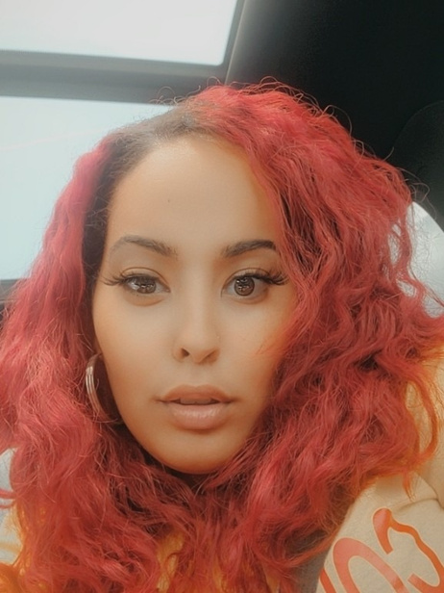


Hello and welcome
to Mrs. Butler's ColorFul Pack. I'm so excited to learn and grow together this year!

Slide 3



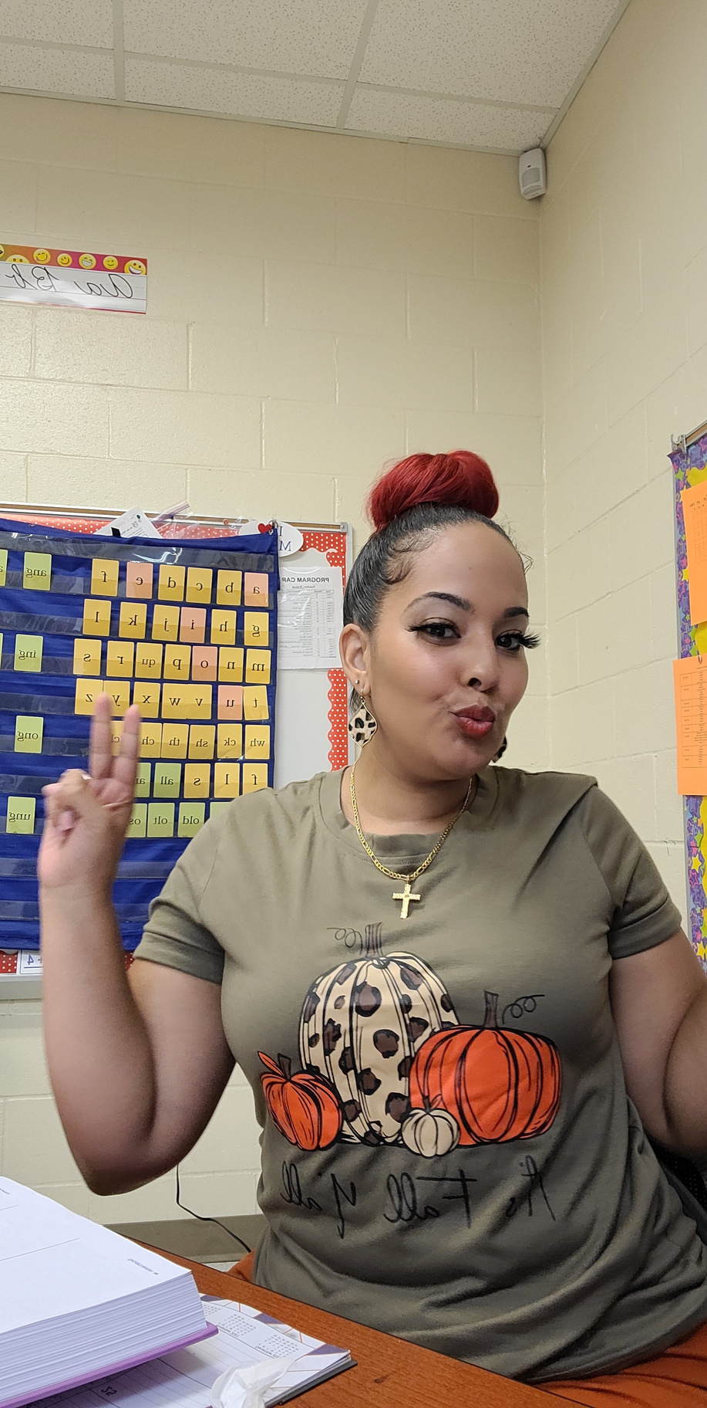


Get to Know Mrs. Butler
Color: Rose Gold
Animal: My dog Benji
Food: Chick-Fil-A or Cheddars
Activity: Shopping, Dancing, and spending time with family/ friends
Ice Cream: Cookies n Cream
Candy: Snickers or Hershey with almonds
Drink: Dunkin Donuts or Starbucks

Slide 4
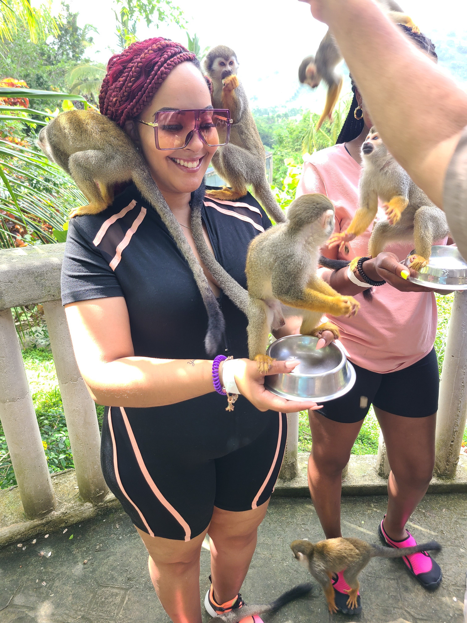
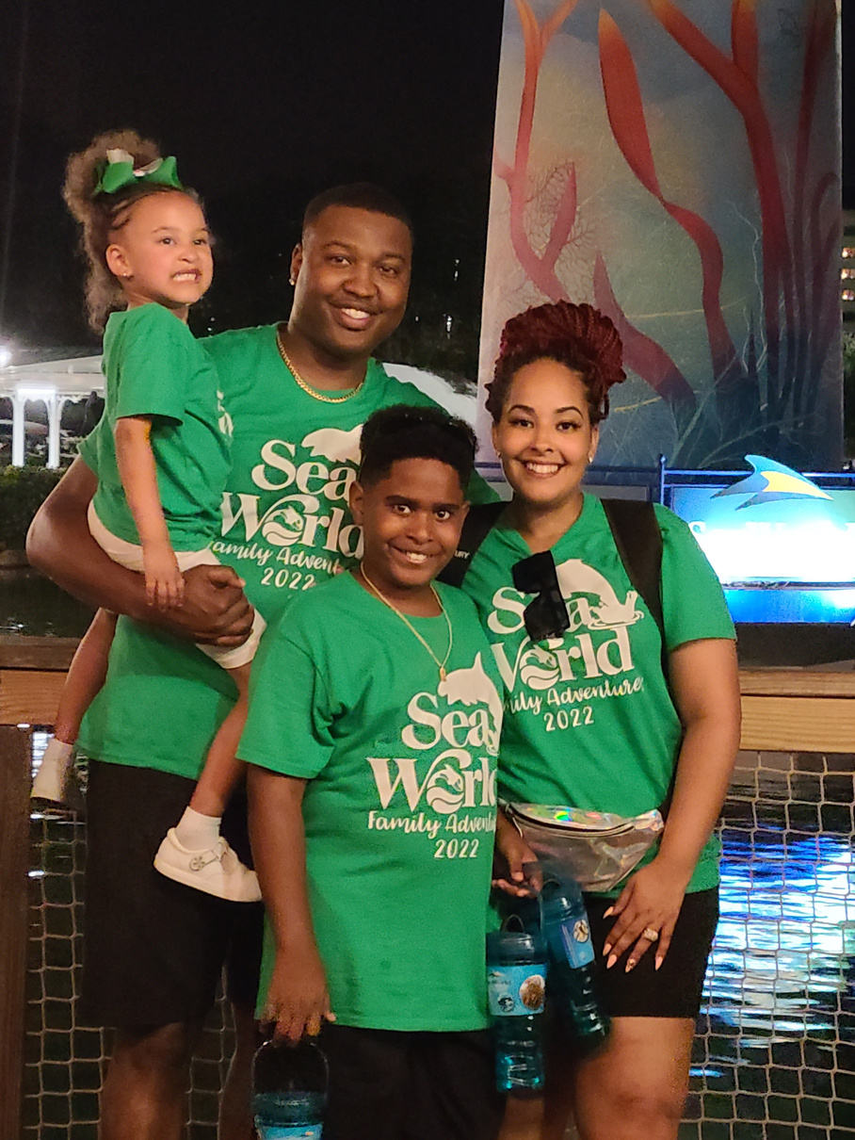
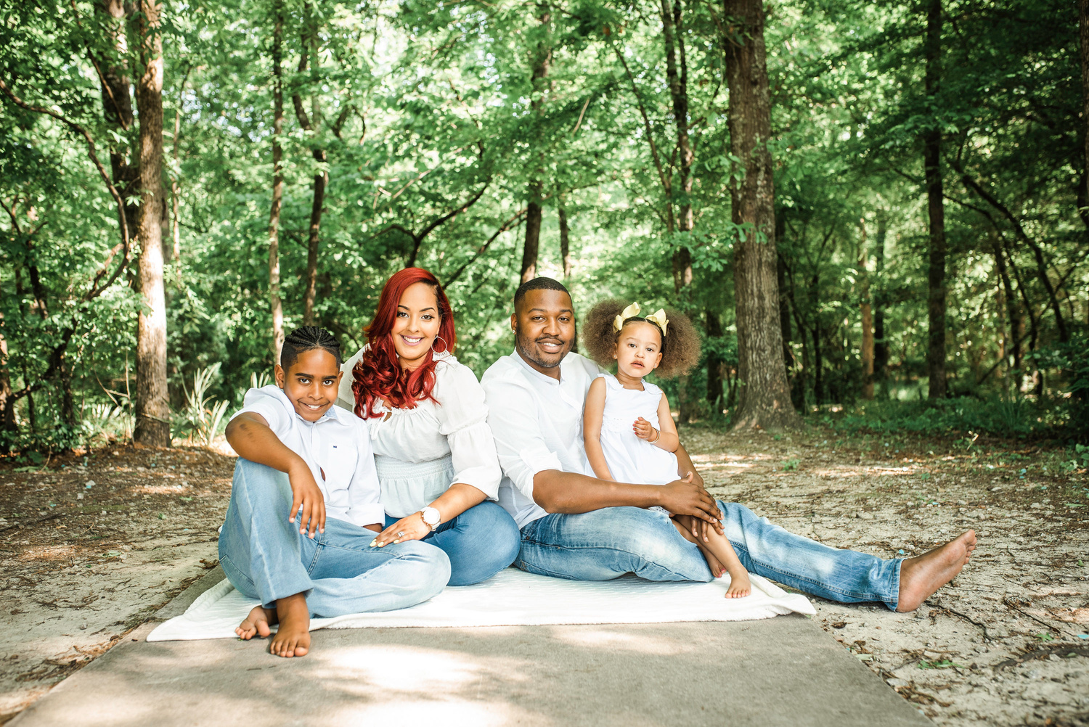
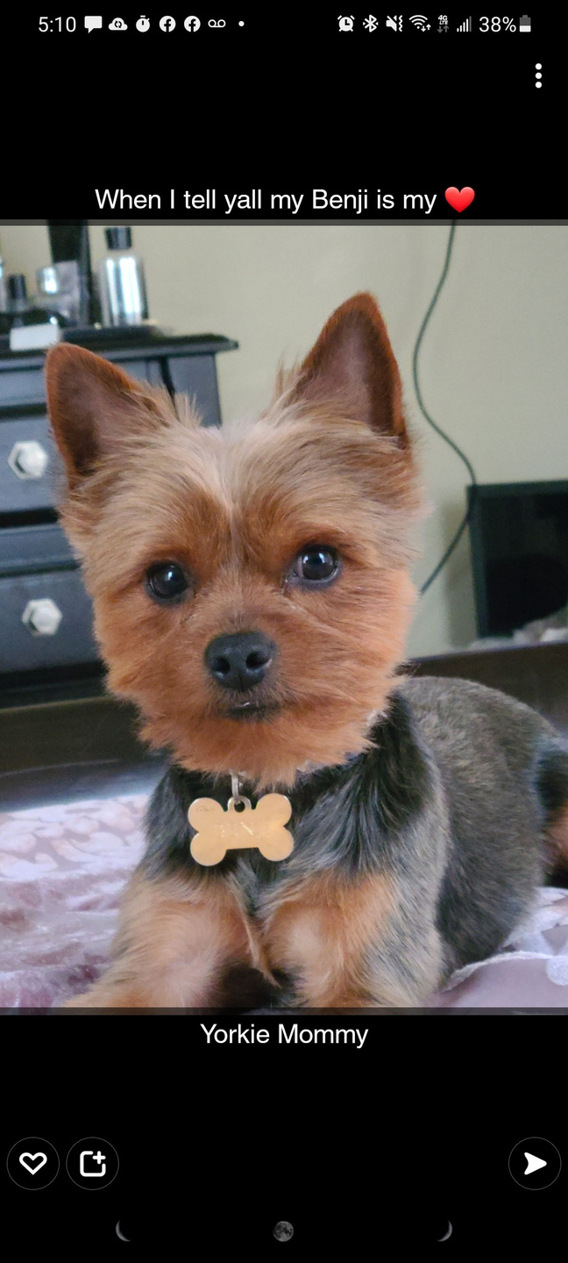
Get to Know Mrs. Butler.....

Slide 5




I believe.....
Mistakes are a part of LEARNING.
We are all lifelong Learners.
Each of you bring your own unique talents, experiences and identity into this classroom.
Everyday is a fresh start and a new opportunity..
I have high expectations because you are all high achievers.

Slide 6

1st Grade Rules
  We will arrive rested and ready to learn EVERYDAY!
  We will follow directions the first time they are given.
  We will treat others with Kindness.
  We will Keep our hands, feet, and bodies to ourselves.
  We will use good manners like "please" and "thank you."

Slide 7


1st Grade Rules
  We will use inside voices and walking feet in the classroom and hallway
  We will apologize!
  We will share!
WE WILL HAVE FUN LEARNING

Slide 8

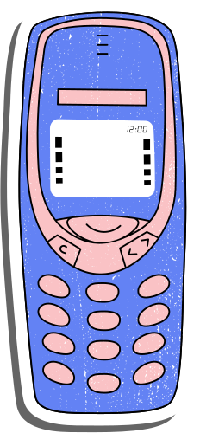

Thank you!
Do you have any questions?
(706) 796-4918

